Slide 1
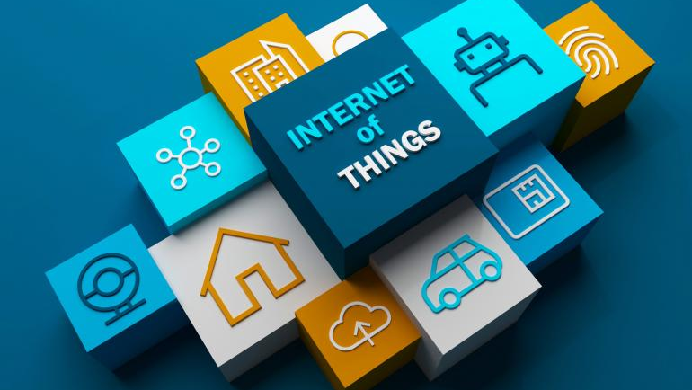
Transition from 1G to 5G

Slide 2
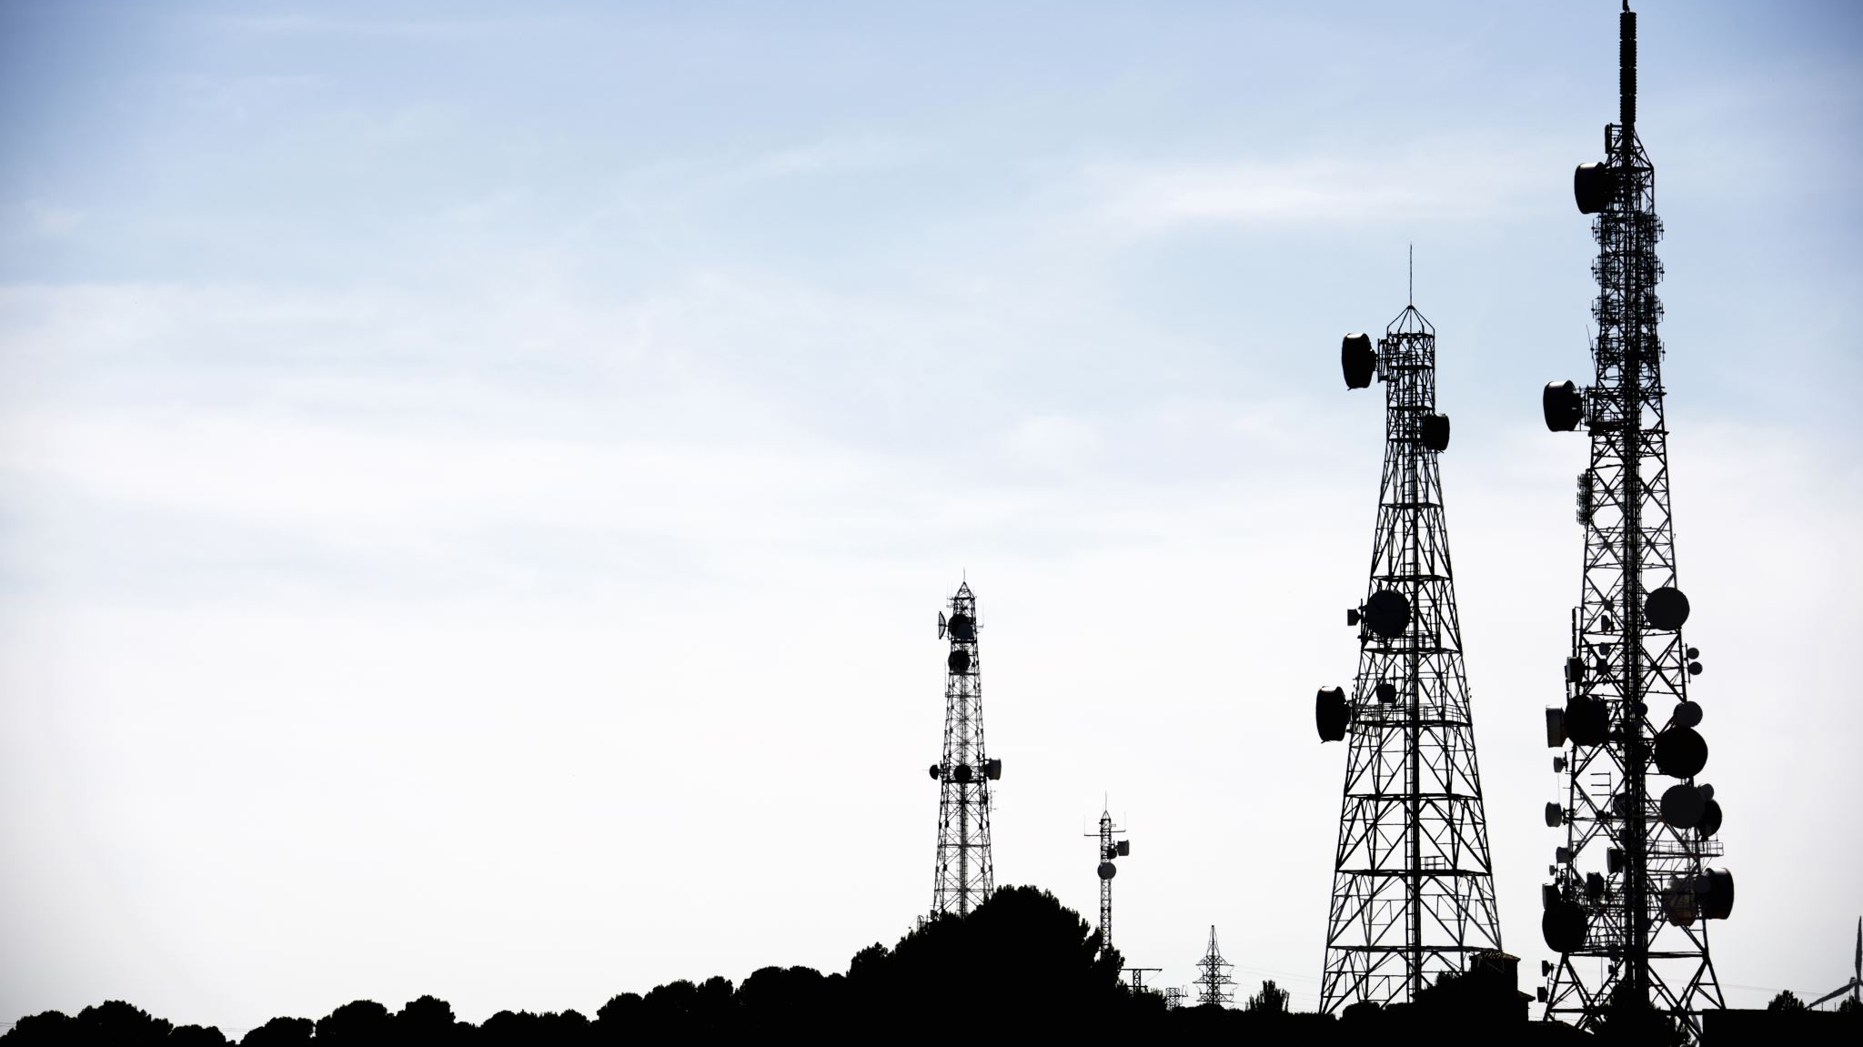
Contents
ABSTRACT
1G – First generation mobile communication system
2G – Second generation communication system GSM
3G – Third generation communication system
4G – Fourth generation communication system
5G – Fifth generation communication system
Comparison of 1G to 5G technology

Slide 3

ABSTRACT
Wireless Mobile Communications have undergone major “generational” changes since MacDonald of Bell Telephone Laboratories introduced the concept of cellular communications in 1979. Over the last four decades, the technology has evolved from the first generation, 1 G, followed by 2 G, 3 G, and 4 G, to reach today’s threshold of the fifth generation, 5 G.

Slide 4

Changes
Cell phones have become smaller.
Download speeds have become faster.
Text messaging has come (and almost gone).
Surfing the internet with phones became common.
The steam of social media posting continues.
And apparently, there’s an app for nearly everything now.

Slide 5
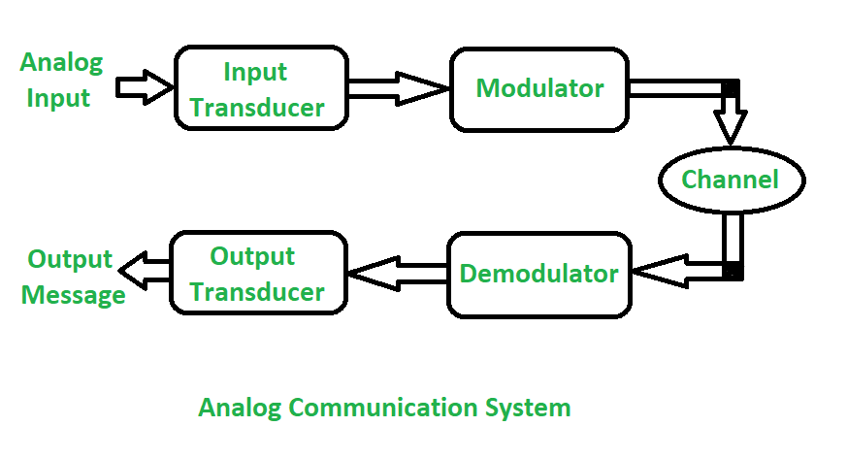
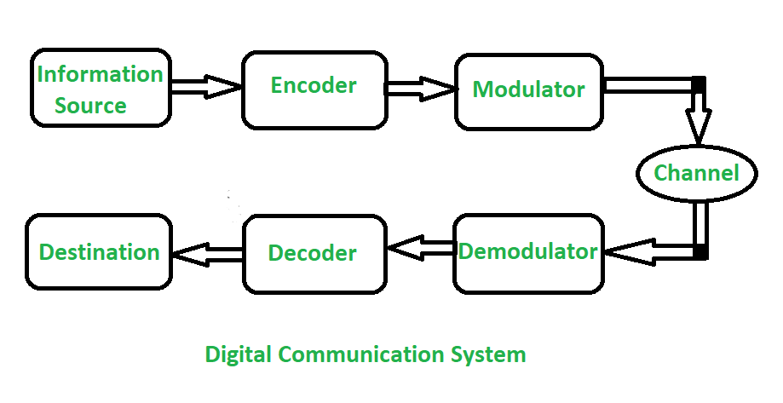
1G – First generation mobile communication system
The first generation of mobile network was deployed in Japan by Nippon Telephone and Telegraph company (NTT) in Tokyo during 1979. In the beginning of 1980s, it gained popularity in the US, Finland, UK and Europe. This system used analogue signals and it had many disadvantages due to technology limitations.

Slide 6
Most popular 1G system during 1980s
Advanced Mobile Phone System (AMPS)
Nordic Mobile Phone System (NMTS)
Total Access Communication System (TACS)
European Total Access Communication System (ETACS)

Slide 7
Advanced Mobile Phone System (AMPS)
The following are features of AMPS
• Mobile Tx/Rx frequency in MHz: 824 to 849(Tx) and 869 to 894 (Rx)
• Duplex scheme : FDD
• Multiple Access Scheme : FDMA
• No. of channels : 832 in AMPS
• Number of users per channel : one
• Spacing between RF channels : 30KHz in AMPS
• Modulation scheme : FM
The following are features of TACS standard.
• Mobile Trx/Rx frequency in MHz : For ETACS 916 to 949 (Rx) and 871 to 904 (Tx), For NTACS 860 to 870 (Rx) and 915 to 925 (Tx)
• Duplex scheme : FDD
• Multiple Access Scheme : FDMA
• No. of channels : 1240 in ETACS and 400 in NTACS
• Spacing between RF channels : 25 KHz in ETACS and 12.5 KHz in NTACS
The following are features of NMT standard.
• Mobile Tx/Rx frequency in MHz : 463 to 468 (Rx) and 453 to 458 (Tx) in NMT-450 standard 935 to 960 (Rx) and 890 to 915 (Tx) in NMT-900 standard
• Duplex scheme : FDD
• Multiple Access Scheme : FDMA
• No. of Channels : 200 in NMT-450 and 1999 in NMT-900
• Spacing between RF channels : 25 KHz in NMT-450 standard and 12.5 KHz in NMT-900

Slide 8
Key features (technology) of 1G system
Advantages of 1G system
Frequency 800 MHz and 900 MHz
Bandwidth: Analog telecommunication (30KHz)
Modulation: Frequency Modulation (FM)
Mode of service: voice only
Access technique: Frequency Division Multiple Access (FDMA)
Technology: Analog cellular
Capacity (data rate): 2kbps

Slide 9
Disadvantages of 1G system
(From 1980 to 1990 )
Poor voice quality due to interference
Poor battery life
Large sized mobile phones (not convenient to carry)
Less security (calls could be decoded using an FM demodulator)
Limited number of users and cell coverage
Roaming was not possible between similar systems

Slide 10
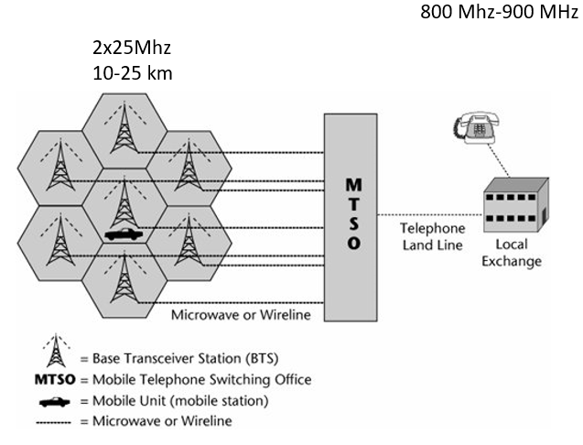
1G Analog Cellular Networks
The cellular radio system has three key components a transceiver station, a mobile telephone switching office (MTSO), and a mobile unit (i.e., the phone).
Each cell needs a base transceiver stationa tower that transmits signals to and from the mobile unit. Each of these base transceiver stations connects to an MTSO. The MTSO then interfaces into the terrestrial local exchanges to complete calls over the PSTN.
The connections from the base transceiver stations to the MTSO can be either microwave or wireline, and then typically from the MTSO to the local exchange there is a wireline facility, but it could also potentially be microwave.

Slide 11
2G – Second generation communication system GSM
Second generation of mobile communication system introduced a new digital technology for wireless transmission also known as Global System for Mobile communication (GSM).
GSM technology became the base standard for further development in wireless standards later.
This standard was capable of supporting up to 14.4 to 64kbps (maximum) data rate which is sufficient for SMS and email services.
Code Division Multiple Access (CDMA) system developed by Qualcomm also introduced and implemented in the mid 1990s.
CDMA has more features than GSM in terms of spectral efficiency, number of users and data rate.

Slide 12
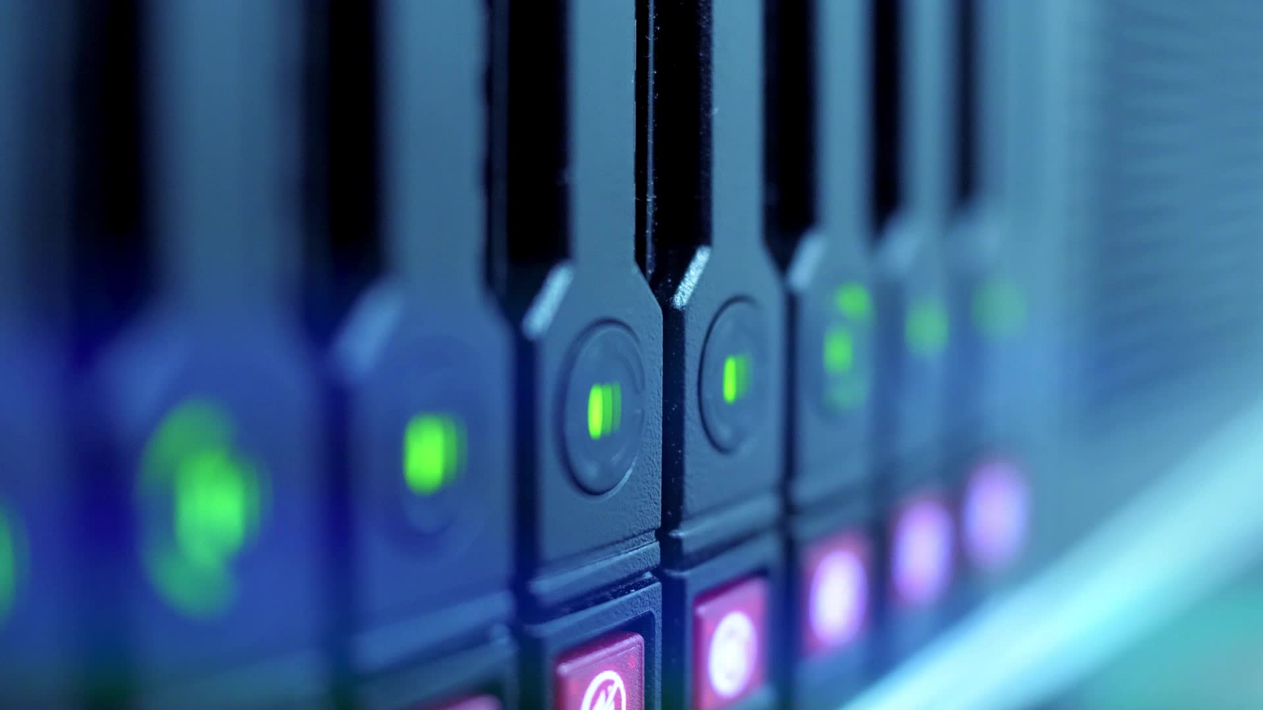
Key features of 2G system
SMS services is possible
Roaming is possible
Enhanced security
Encrypted voice transmission
First internet at lower data rate
Disadvantages of 2G system
Low data rate
Limited mobility
Less features on mobile devices
Limited number of users and hardware capability

Slide 13
2.5G and 2.75G system
In order to support higher data rate, General Packet Radio Service (GPRS) was introduced and successfully deployed.
GPRS was capable of data rate up to 171kbps (maximum).
EDGE – Enhanced Data GSM Evolution also developed to improve data rate for GSM networks.
EDGE was capable to support up to 473.6kbps (maximum).
Another popular technology CDMA2000 was also introduced to support higher data rate for CDMA networks.
This technology has the ability to provide up to 384 kbps data rate (maximum).

Slide 14
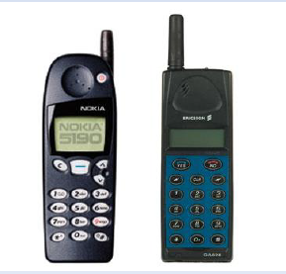
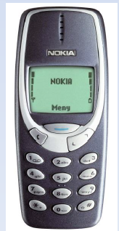
2G
•Frequency: 1.8GHz (900MHz), digital telecommunication
•Bandwidth: 900MHz (25MHz)
•Characteristic: Digital
•Technology: Digital cellular, GSM
•Capacity (data rate): 64kbps
•Why better than 1G?
•From 1991 to 2000
•Allows txt msg service
•Signal must be strong or else weak digital signal
•2.5G
–2G cellular technology with GPRS
–E-Mails
–Web browsing
–Camera phones
2G capabilities are achieved by allowing multiple users on a single channel via multiplexing. During 2G Cellular phones are used for data also along with voice. The advance in technology from 1G to 2G introduced many of the fundamental services that we still use today, such as SMS, internal roaming , conference calls, call hold and billing based on services e.g. charges based on long distance calls and real time billing. The max speed of 2G with General Packet Radio Service ( GPRS ) is 50 Kbps or 1 Mbps with Enhanced Data Rates for GSM Evolution ( EDGE ).

Slide 15
3G – Third generation communication system
Third generation mobile communication started with the introduction of UMTS – Universal Mobile Terrestrial / Telecommunication Systems.
UMTS has the data rate of 384kbps and it support video calling for the first time on mobile devices.
After the introduction of 3G mobile communication system, smart phones became popular across the globe.
Specific applications were developed for smartphones which handles multimedia chat, email, video calling, games, social media and healthcare.

Slide 16
Key features of 3G system
Higher data rate
Video calling
Enhanced security, more number of users and coverage
Mobile app support
Multimedia message support
Location tracking and maps
Better web browsing
TV streaming
High quality 3D games

Slide 17
3.5G to 3.75 Systems
In order to enhance data rate in existing 3G networks, another two technology improvements are introduced to network.
HSDPA – High Speed Downlink Packet access and HSUPA – High Speed Uplink Packet Access, developed and deployed to the 3G networks.
3.5G network can support up to 2mbps data rate.
3.75 system is an improved version of 3G network with HSPA+ High Speed Packet Access plus.
Later this system will evolve into more powerful 3.9G system known as LTE (Long Term Evolution).

Slide 18
Disadvantages of 3G systems
Expensive spectrum licenses
Costly infrastructure, equipment and implementation
Higher bandwidth requirements to support higher data rate
Costly mobile devices
Compatibility with older generation 2G system and frequency bands

Slide 19
4G – Fourth generation communication system
4G systems are enhanced version of 3G networks developed by IEEE, offers higher data rate and capable to handle more advanced multimedia services.
LTE and LTE advanced wireless technology used in 4th generation systems.
Furthermore, it has compatibility with previous version thus easier deployment and upgrade of LTE and LTE advanced networks are possible.
Simultaneous transmission of voice and data is possible with LTE system which significantly improve data rate.
All services including voice services can be transmitted over IP packets.
Complex modulation schemes and carrier aggregation is used to multiply uplink / downlink capacity.
Wireless transmission technologies like WiMax are introduced in 4G system to enhance data rate and network performance.

Slide 20
Key features of 4G system
Much higher data rate up to 1Gbps
Enhanced security and mobility
Reduced latency for mission critical applications
High definition video streaming and gaming
Voice over LTE network VoLTE (use IP packets for voice)

Slide 21
Disadvantages of 4G system
Expensive hardware and infrastructure
Costly spectrum (most countries, frequency bands are too expensive)
High end mobile devices compatible with 4G technology required, which is costly
Wide deployment and upgrade is time consuming

Slide 22
5G – Fifth generation communication system
5G network is using advanced technologies to deliver ultra fast internet and multimedia experience for customers. Existing LTE advanced networks will transform into supercharged 5G networks in future.
In earlier deployments, 5G network will function in non standalone mode and standalone mode. In non standalone mode both LTE spectrum and 5G-NR spectrum will be used together. Control signaling will be connected to LTE core network in non standalone mode.
There will be a dedicated 5G core network higher bandwidth 5G – NR spectrum for standalone mode. Sub 6-GHz spectrum of FR1 ranges are used in the initial deployments of 5G networks.
In order to achieve higher data rate, 5G technology will use millimeter waves and unlicensed spectrum for data transmission. Complex modulation technique has been developed to support massive data rate for Internet of Things.
Find more about what is 5G NR (New Radio) and how 5G NR works
Cloud based network architecture will extend the functionalities and analytical capabilities for industries, autonomous driving, healthcare and security applications.

Slide 23
Key features of 5G technology
Ultra fast mobile internet up to 10Gbps
Low latency in milliseconds (significant for mission critical applications)
Total cost deduction for data
Higher security and reliable network
Uses technologies like small cells, beam forming to improve efficiency
Forward compatibility network offers further enhancements in future
Cloud based infrastructure offers power efficiency, easy maintenance and upgrade of hardware

Slide 24
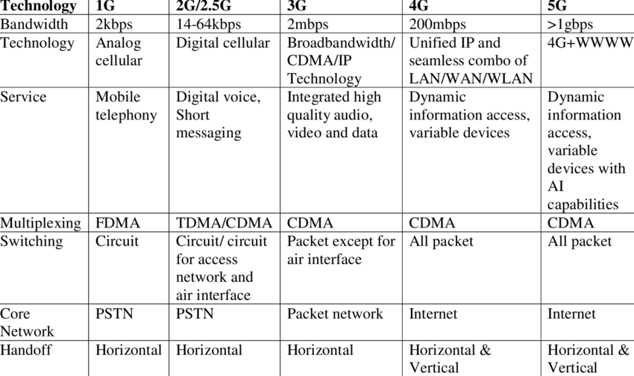
Comparison of 1G to 5G technology

Slide 25
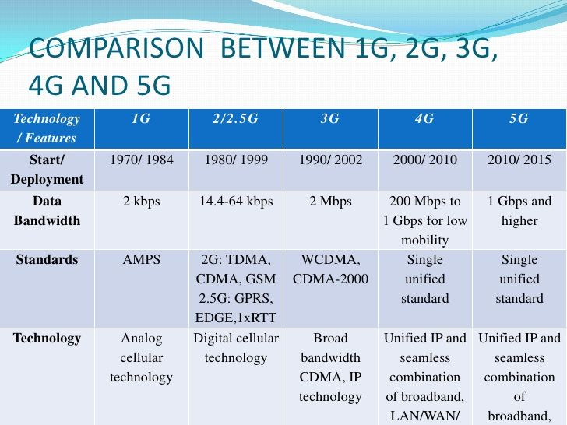

Slide 26
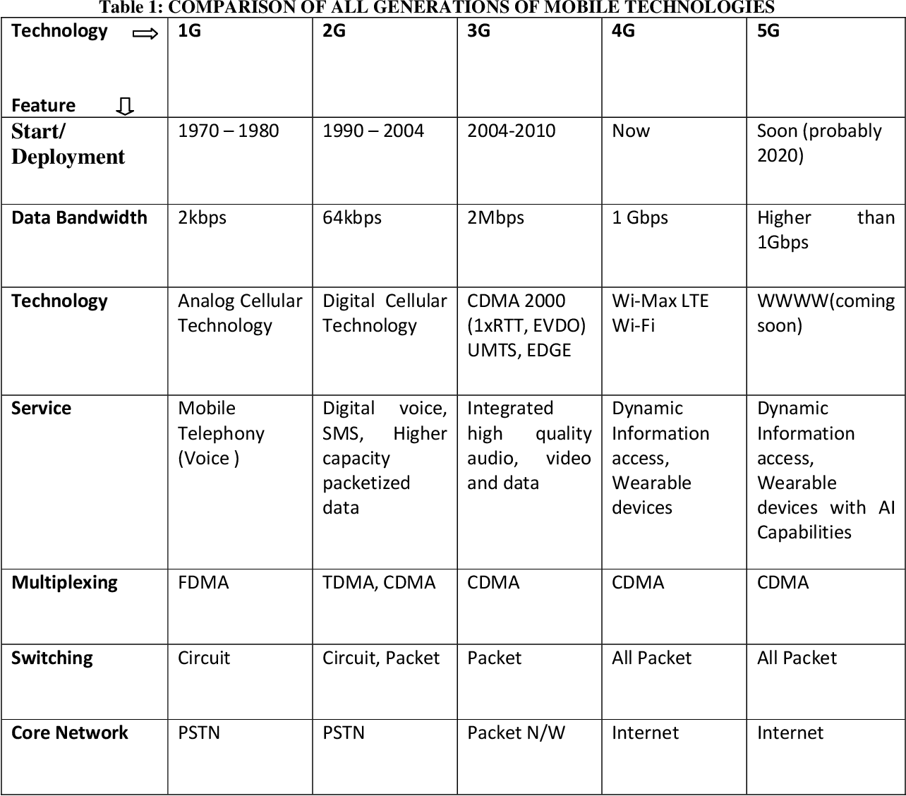

Slide 27
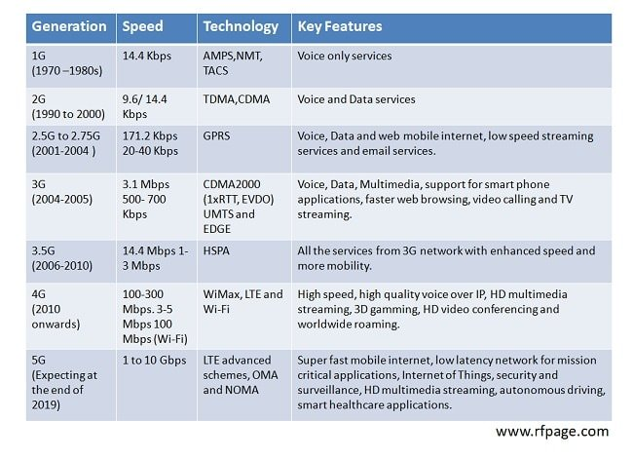

Slide 28
Sources
https://www.7layers.com/en/technologies/2g/#:~:text=As%20in%20the%20case%20of,of%20up%20to%20220%20Kbps.
http://www.slideshare.net/kaushal_kaith/3g-4g-5g
https://www.youtube.com/watch?v=hWHXTbdCe5Q
http://www.marieclaire.co.uk/blogs/549946/1980s-fashion-icons-eighties-fashion-80s-style-moments.html
https://en.wikipedia.org/wiki/1G
http://www.zseries.in/telecom%20lab/telecom%20generations/#.V9LDI_mLRhE
http://www.speedguide.net/faq/what-are-1g-2g-3g-and-4g-networks-365
http://infoboxdaily.com/wp-content/uploads/2014/10/eden.dei.uc.pt_~vasco_Papers_files_Mobile_evolution_v1.5.1.pdf
http://d.researchbib.com/f/annJcwp21wYzAioF9xo2AmY3OupTIlpl9OqJq1p3DlZQRmY1LlFGtlZQRmZGphpTEz.pdf
https://5g.co.uk/guides/5g-frequencies-in-the-uk-what-you-need-to-know/
https://www.linkedin.com/pulse/evolution-mobile-communication-from-1g-4g-5g-6g-7g-pmp-cfps
https://www.youtube.com/watch?v=2jAk-tVDKtc
http://www.gsmarena.com/network-bands.php3
http://www.slideshare.net/nimay1/mobile-tower-site
http://www.futuretimeline.net/blog/2015/01/22.htm#.V9e4TvmLRhE
http://www.phonearena.com/news/1G-2G-3G-4G-The-evolution-of-wireless-generations_id46952
http://gizmodo.com/what-is-5g-and-how-will-it-make-my-life-better-1760847799

